Slide 1


Approaches to Teaching R
By: Jenny Sloane
https://jennysloane.netlify.app/
@jfsloane
https://github.com/jennysloane/teaching-r

Slide 2

About Me
Born and raised in Baltimore, Maryland
Recently submitted my PhD in cognitive psychology from UNSW in Sydney
Studying the effects of interruptions on decision-making
I love teaching R, especially to beginners and younger students
Artwork by @allison_horst
Notes:
Experience teaching R to year 7-9 students, year 11 students, and uni students

Slide 3
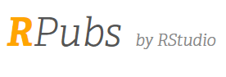

Tools and Tips for Teaching R
Websites
Blogs & Tutorials
Notes:
4 general topics I’ll cover
First 2 – online platforms that are great for teaching

Slide 4
What online platforms would I recommend for teaching R?

Slide 5
“Data science without the hardware hassles”
Getting started is often the hardest part
Install R, download RStudio, install packages, load packages, etc.
Using RStudio cloud avoids all the hassle!
Plans: free, premium, instructor, organization
Notes:
After teaching a couple of courses and workshops using Rstudio cloud, I can’t imagine trying to teach without – I highly recommend it! Especially because the pricing for the instructor plan is pretty reasonable
Log in via github
Go to NEWScribo workspace
Your Projects
Show example of final_project – similar to Rstudio but on the cloud
As the instructor, you can go through and design your lesson making sure to install all of the necessary packages, but then the packages will be installed for everyone automatically so they just need to load the libraries
Assignments – under Your Projects, click the 3 dots for settings, go to Access, select Make this project an assignment
Instructor/admin has access to all the students’ projects so it’s really easy to check in and help troubleshoot – although from memory, only one person can be logged in at a time

Slide 6
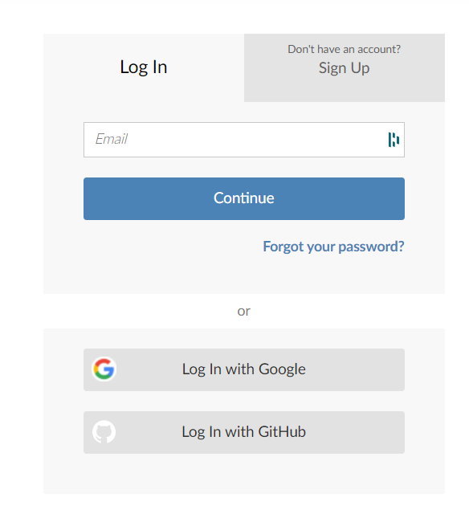
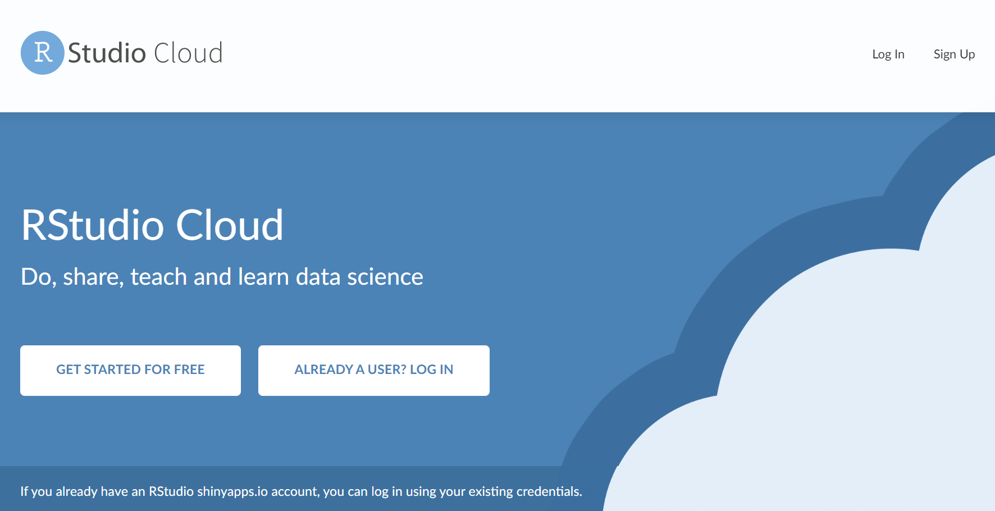
Log in: sign up or log in through Google or GitHub
https://rstudio.cloud/
Notes:
After teaching a couple of courses and workshops using Rstudio cloud, I can’t imagine trying to teach without – I highly recommend it! Especially because the pricing for the instructor plan is pretty reasonable
Log in via github
Go to NEWScribo workspace
Your Projects
Show example of final_project – similar to Rstudio but on the cloud
As the instructor, you can go through and design your lesson making sure to install all of the necessary packages, but then the packages will be installed for everyone automatically so they just need to load the libraries
Assignments – under Your Projects, click the 3 dots for settings, go to Access, select Make this project an assignment
Instructor/admin has access to all the students’ projects so it’s really easy to check in and help troubleshoot – although from memory, only one person can be logged in at a time

Slide 7
You can create different workspaces and projects within the workspaces
Projects can easily be turned into “assignments” which is a great teaching tool
Everyone who is in the workspace can start working on the assignment
Tip: For beginners, I like to create a “template” and an “answers” script
Notes:
Log in via github
Go to NEWScribo workspace
Your Projects
Show example of final_project – similar to Rstudio but on the cloud
As the instructor, you can go through and design your lesson making sure to install all of the necessary packages, but then the packages will be installed for everyone automatically so they just need to load the libraries
Assignments – under Your Projects, click the 3 dots for settings, go to Access, select Make this project an assignment
Instructor/admin has access to all the students’ projects so it’s really easy to check in and help troubleshoot – although from memory, only one person can be logged in at a time

Slide 8
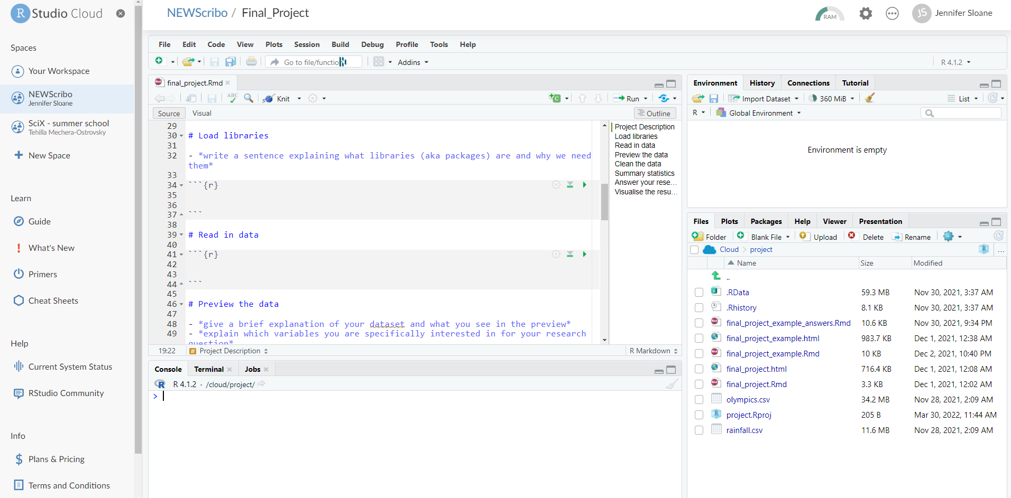
Example Template

Slide 9
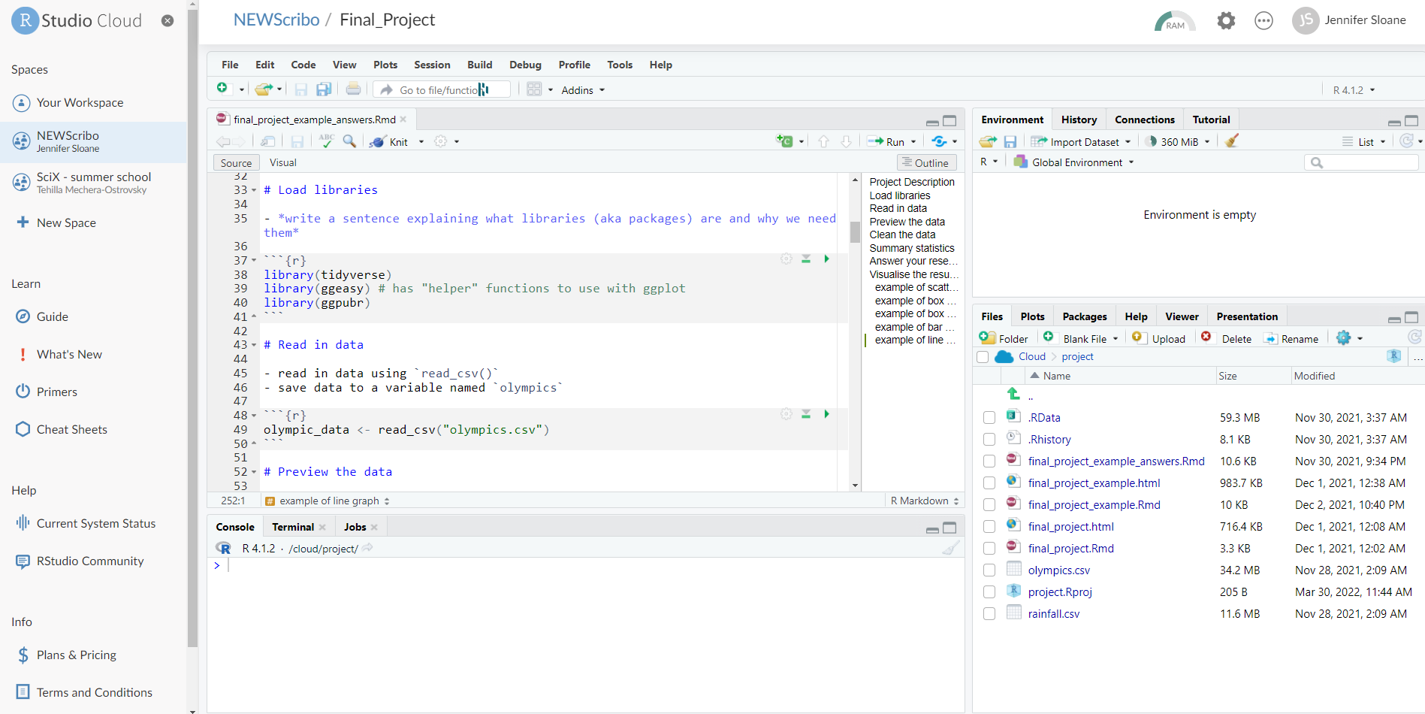
Example Answers

Slide 10
You can create different workspaces and projects within the workspaces
Projects can easily be turned into “assignments” which is a great teaching tool
Tip: For beginners, I like to create a “template” and an “answers” script
As the instructor/admin, you have access to all the projects
Great for checking in on students
Great for troubleshooting
Notes:
Log in via github
Go to NEWScribo workspace
Your Projects
Show example of final_project – similar to Rstudio but on the cloud
As the instructor, you can go through and design your lesson making sure to install all of the necessary packages, but then the packages will be installed for everyone automatically so they just need to load the libraries
Assignments – under Your Projects, click the 3 dots for settings, go to Access, select Make this project an assignment
Instructor/admin has access to all the students’ projects so it’s really easy to check in and help troubleshoot – although from memory, only one person can be logged in at a time

Slide 11
Free and easy to use!
Great for publishing and sharing R Markdown documents straight from Rstudio
Create an R Markdown document
Knit the file to see a preview
In the viewer pane, click publish and select RPubs
Note: you can easily update existing document
I’ve used RPubs to:
Share code and notes from courses with university students
Share code from RLadies meet-ups
https://rpubs.com/
Notes:
Click on getting started – need R Rstudio and knitr
https://cran.r-project.org/web/packages/rpubs/readme/README.html – save as .R and will create an R script with just the r code

Slide 12
Let’s test it out!

Slide 13
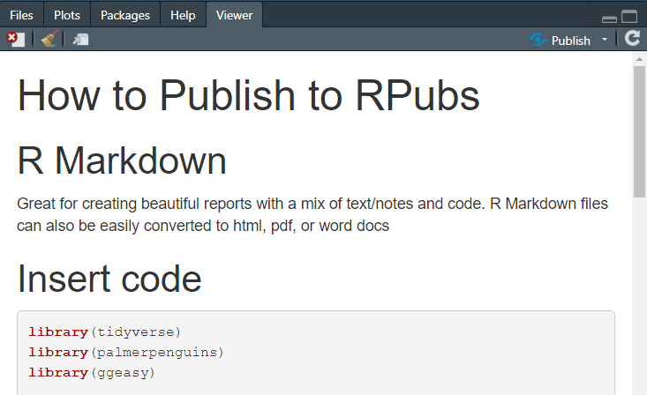
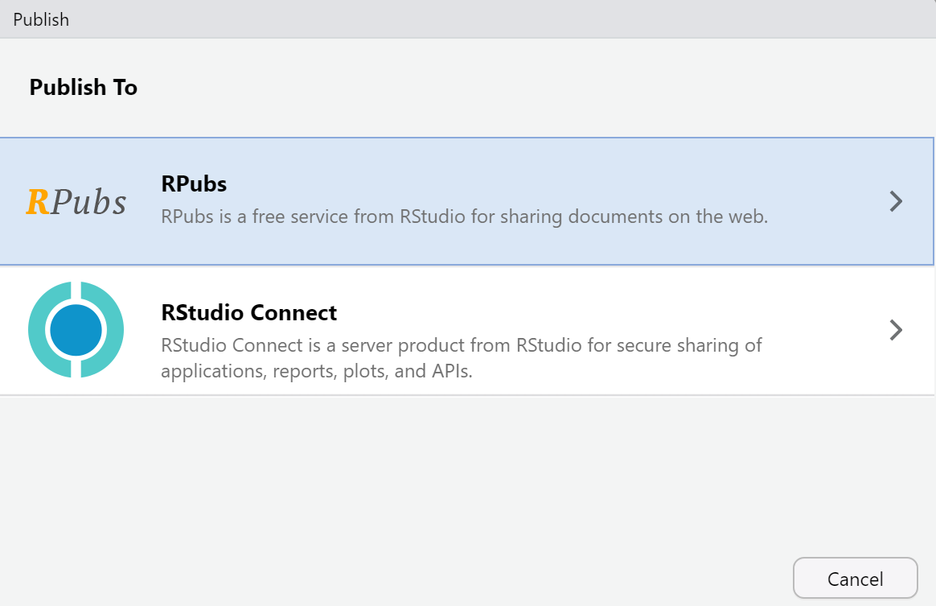
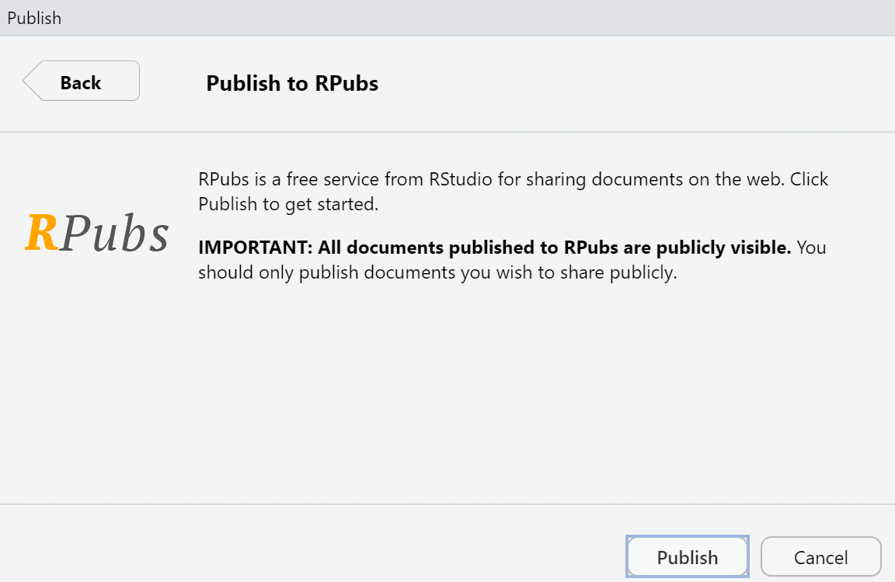
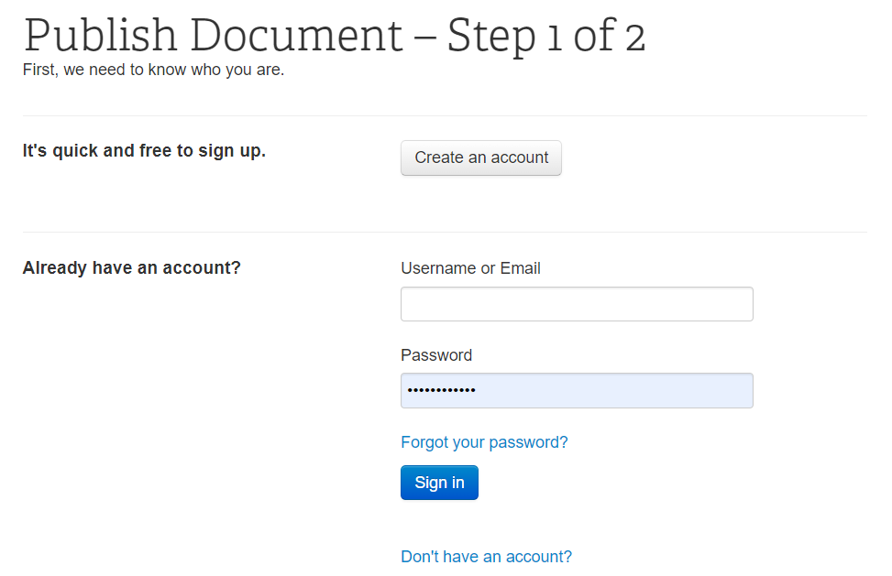
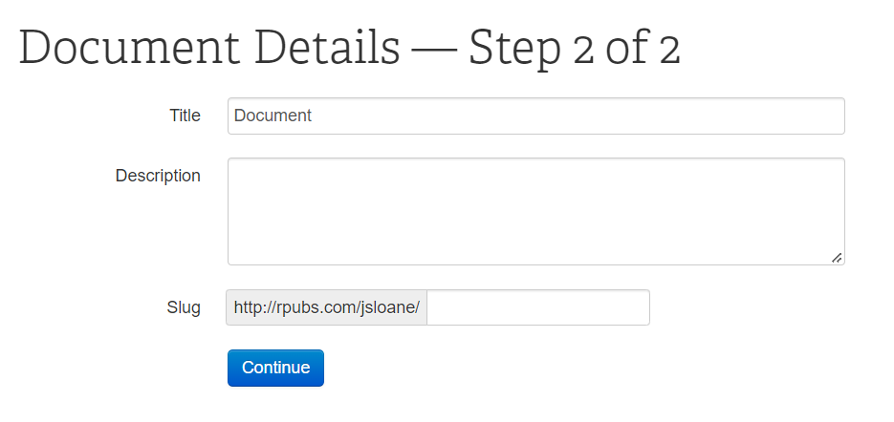

Slide 14
In terms of content and teaching material, where should you start?

Slide 15
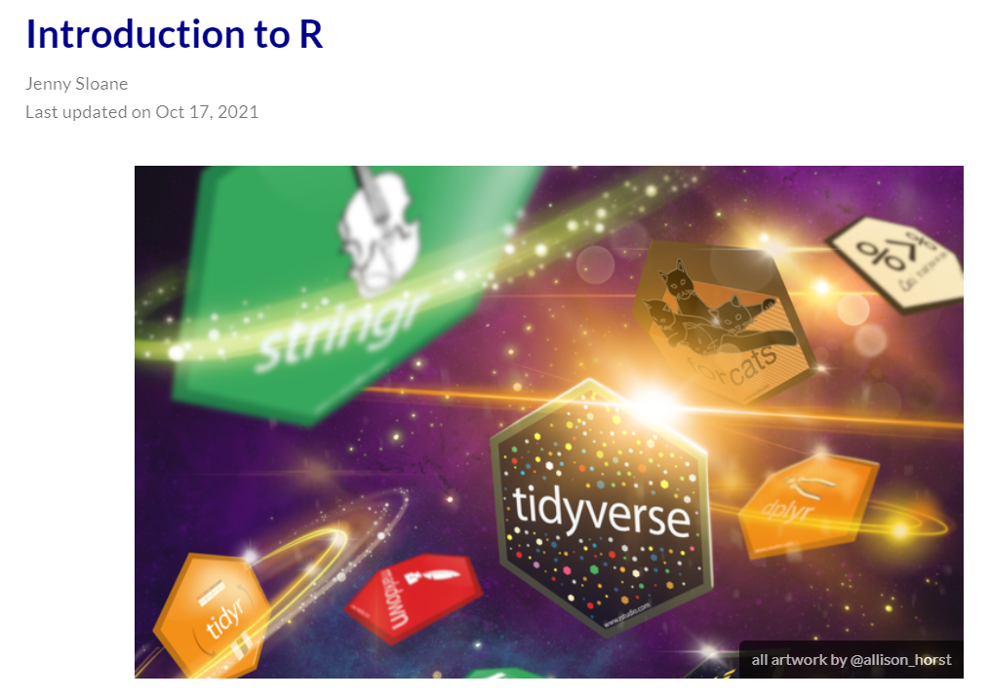
Blogs & Tutorials
Before spending hours creating content, see what’s already out there
R Resources for Beginners
Introduction to R Blog
Notes:
Summer school with high school students, we had them go through RYouWithMe tutorials as pre-work just as a brief introduction to R and Rstudio
For a university course I helped teach, at the start of the term students went through Dani’s YouTube playlists and then I taught the lessons posted on Rpubs

Slide 16
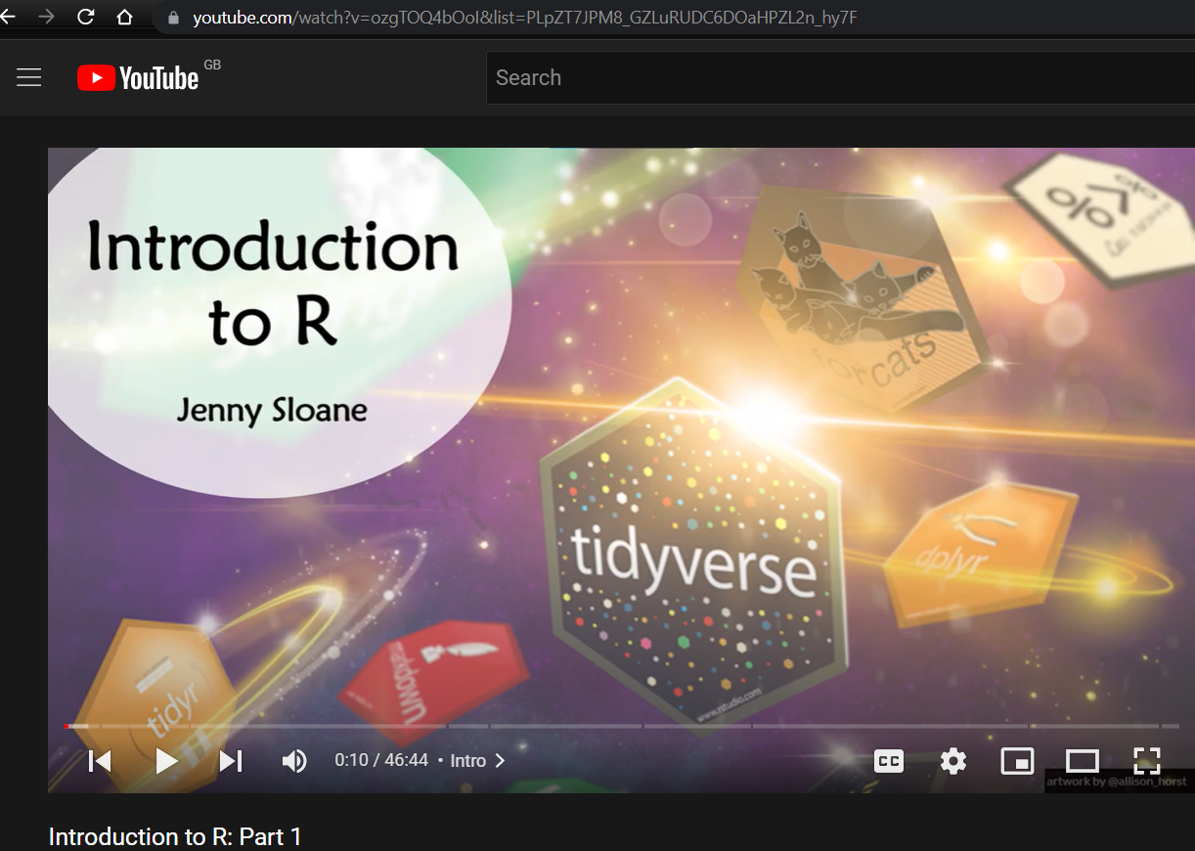
Blogs & Tutorials
Sometimes blog posts can feel a bit overwhelming, especially if you’re trying to learn something new
This is where tutorials can be super useful
I find video tutorials are often more interactive and easier to follow along
Introduction to R Tutorials
learnr example
Notes:
Something on my to do list: learnR interactive blog

Slide 17


Websites
A bit more ambitious and advanced, but creating websites can be a great tool for teaching and sharing content
Distill
Great for making “simple” websites relatively quickly and easily
Great for blogs
Less flexibility
Great tutorial for building websites with Distill by Dr. Maria Tackett
NEWScribo Website
R Girls Website

Slide 18
Websites
A bit more ambitious and advanced, but creating websites can be a great tool for teaching and sharing content
Blogdown
Much more flexibility in terms of design and layout
More complicated file structure
Takes longer to get the hang of
Alison Hill's Blog: Up & Running with Blogdown
My R Blogdown Blog
R Blogdown YouTube Playlist
My Academic Website
UNSW CodeRs Website

Slide 19
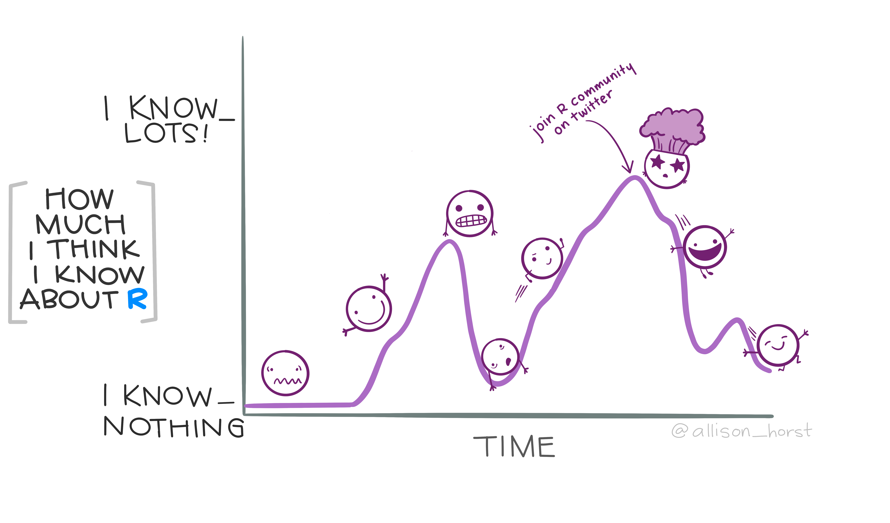
General Tips
Don’t skip over the basics
Installing and loading packages, understanding working directories, different types of variables, data frames, etc.
Consider age and if the students have any prior coding experience
Have a fun and concrete project
Be prepared to be amazed by how quickly students learn
Enjoy being part of the R community!

